Slide 1

EQUALITY SERIES
GENDER EQUALITY- Video and Education Resource

Slide 2

INTRODUCTION
The AFL ‘Equality’ video series and resources have been developed by the Cultural Strategy & Education unit within the AFL to assist community football clubs around Australia in providing education to their players on key social issues. The series consists of 4 clips and accompanying resources. Each clip features a football or sport related personality discussing a social issue that has impacted them personally. The Equality Series includes the following clips:
The clips and accompanying resources can be found on the AFL Respect and Responsibility webpage alongside the tabs that relate to the corresponding social issue. Within each tab, you will find a resource that provides information on how to present the education in your club, key questions to discuss, the key messages to get across and a fact sheet on the selected topic.
The clips featured in this series are being used to educate and raise awareness across the AFL industry on the impact that discrimination and vilification can have on individuals and their families.
HOMOPHOBIA – Jason Ball | MENTAL HEALTH – Simon Hogan
GENDER EQUALITY – Peta Searle | RACIAL VILIFICATION – Joel Wilkinson

Slide 3
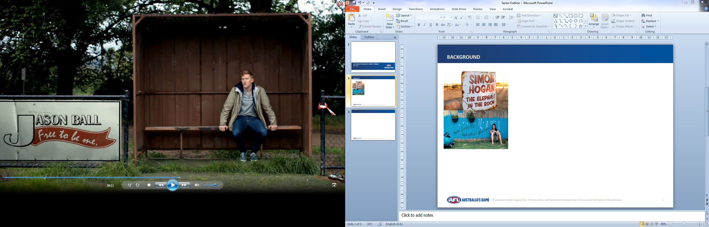

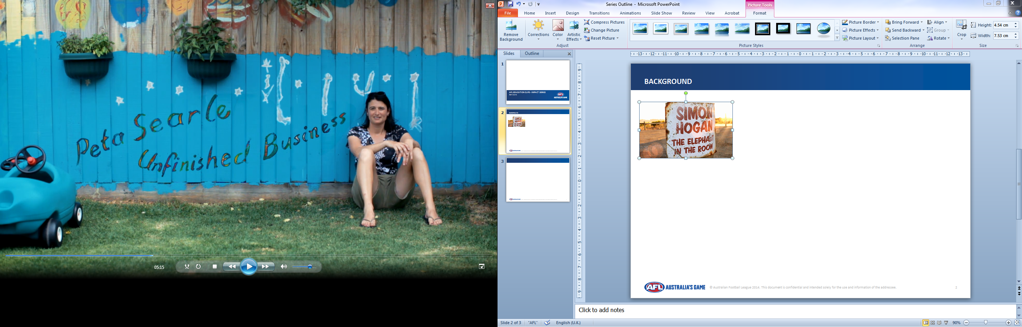
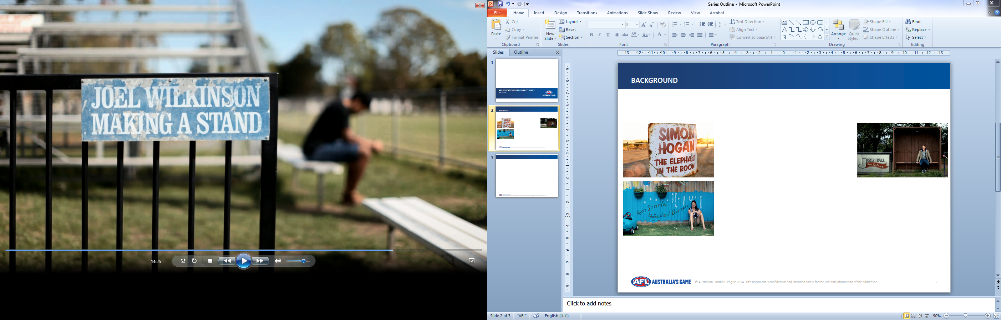
USING THE RESOURCE
OPTION 1: YOUR OWN EDUCATION
PURPOSE: To develop your own understanding and knowledge on these topics
PREPARATION: Download clips and AFL social inclusion and equality resource which can be found on the AFL Respect and Responsibility website.
MATERIALS: Laptop/PC
TIMING: 10-15 minutes per topic
FORMAT: Watch the clip yourself. Think about the questions and read over the fact sheets to develop your own understanding of the issue
OPTION 2: PLAYER EDUCATION (RECOMMENDED)
PURPOSE: To educate players within your own club
PREPARATION: Download the clip/s and Equality Resource (topic of your choice)
MATERIALS: TV and/or projector, laptop, screen/blank wall, speakers, butchers paper and markers
TIMING: 15-20 minutes per topic including clip and discussion
FORMAT: Show clip to the group and run activity/discussion as per the accompanying resource

Slide 4

RUNNING A SESSION
PLAYER EDUCATION: HOW TO RUN A SESSION IN YOUR CLUB Decide which clips you want to show. Read over the fact sheet, discussion points and key messages of the clips you have chosen and familiarise yourself with the content. Think about the questions you may get asked. Prepare any materials you need in advance – e.g. paper, pens, butcher’s paper and markers. Organise a space for the session. Make sure it is private and without distractions, such as the club rooms. If you think you need some support, request assistance from a local community worker/social worker/school teacher etc. to assist. Allow enough time to work through each session. At least 20 minutes is recommended per clip. 5 minutes to show the clip and 15-20 minute discussion time. Also allow enough time for questions from participants.

Slide 5
RESPONDING TO DISCLOSURES
FACILITATOR TIPS
Continually throw questions to the group. If, as a facilitator, you are asked a question, don’t always answer it yourself. Throw the question to the group, and allow that to spark or continue to drive discussion
Occasionally somebody might say something that stops you in your tracks. It is important to stay calm and address the comment with respect. If possible, try to suggest an alternate viewpoint or throw it to the rest of the group. It is important not to enter into a public argument.
It is very important to ensure that you have relevant support services referral information and phone numbers to pass onto your participants. National support services are listed under each topic in this resource but you may want to identify local support services in your area.
When facilitating the sessions:
Begin the session with a group agreement around respect. Four or five group rules are usually enough and may include;
Confidentiality –nothing leaves the room
Listening and not interrupting
Showing respect for other people’s comments and opinions
Using third person -not telling personal stories
Choose how much to participate -it’s ok to pass on questions or opt out
If you get a question that you don’t know the answer to, don’t panic. Admit that you don’t know the answer. You do not want to lie or invent information that isn’t true, as you lose all credibility. Reassure the person that you will follow up with them regarding the question after the session and that an answer will be provided in due time.
At the end of the session provide an opportunity for participants to follow up with yourself to provide information regarding support services, referrals and websites.
YOU ARE NOW READY TO PLAY THE CLIP AND BEGIN YOUR SESSION

Slide 6
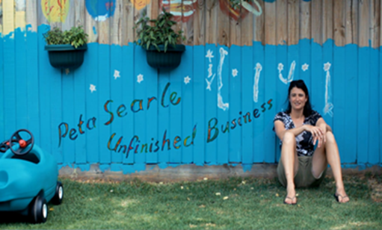
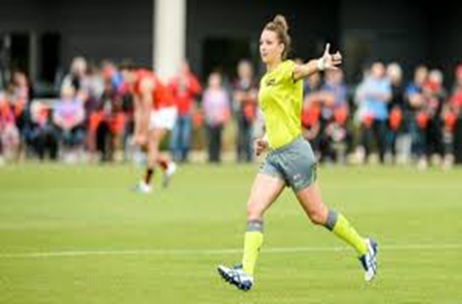
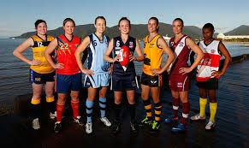
DISCUSSION POINTS
GENDER EQUALITY
Females shouldn’t have to possess masculine traits in order to succeed in male dominated industries.
Women bring different insights and experiences to the football industry.
Sexism still exists in the community and can make the career progression of females in various industries much more difficult.
Whilst the roles of females in football has increased significantly over the last 10-15 years, women are still severely under-represented when it comes to the operational side of football such as coaching, playing, etc.
KEY MESSAGES
QUESTIONS
Do you think there is a place for female coaches in the AFL or community football club system?
What do you think a female coach could bring to your club?
What do you think is stopping more female coaches being employed at an AFL club?
How would you feel having a female coach?

Slide 7
FACT SHEET
STATISTICS
Peta Searle was the first female coach ever of a VFL team in Australia and in June 2014 became an assistant coach at St Kilda.
There are currently around 25,000 women playing Australian Rules football in Australia
2200 accredited female coaches
35% of AFL members are women
42% of national TV audience are women
WHAT IS THE DIFFERENCE BETWEEN GENDER AND SEX?
Sex is biological and someone is generally born as male or female. Gender describes the characteristics that a society or culture describes as masculine or feminine.
Gender stereotypes are the generalisations about the roles of each gender and the different behaviours, clothing and personality etc. that are expected from men and women. Gender stereotypes generally suggest that men should be masculine and women should be feminine and this can negatively impact both men and women.
Gender inequality refers to unequal treatment or perceptions of individuals based on their gender. This treatment and perception can impact jobs, employment opportunity, finances and social factors. Gender inequality is believed to be the primary cause of violence against women, as some men believe women are inferior to them, just because they are women, and should be submissive and be controlled by men.
Research suggests that those men who perpetrate violence against women believe and adhere to gender stereotypes and believe women are inferior to men.
GENDER STEREOTYPES
The below examples outline some traditional attitudes and behaviours relating to gender that are considered risky and lead to unhealthy relationships between men and women.
For women
  Women clean, cook and look after the children
  Women should earn less money than men and don’t need an education
  Women should be feminine and emotional and shouldn’t have jobs such as a mechanic or truck driver, or play masculine sports
For Men
  Men are strong and good at sports, like fishing, camping and being outdoors.
  Men should be in charge of a relationship
  Men don’t cook, clean, sew or do crafts and do not get emotional

Slide 8
SUPPORT SERVICES
ORGANISATION | PHONE | WEBSITE
WOMENS FAMILY VIOLENCE SUPPORT SERVICES | 1800 015 188 | http://www.wdvcs.org.au/
LIFELINE | 13 11 14 | http://www.lifeline.org.au/
MENSLINE | 1300 789 978 | http://www.mensline.org.au/
RELATIONSHIPS AUSTRALIA | 1300 364 277 | http://www.relationships.org.au/
CENTRES AGAINST SEXUAL ASSAULT | 9635 3600 | www.casahouse.com.au
1800 RESPECT | 1800 737 732 | https://www.1800respect.org.au/

Slide 9


